Slide 1
Preparing the Twin Cities Model for Pandemic-Related Uncertainty
Modeling Mobility Conference
September 14, 2025
Andrew Rohne

Slide 2
Disclaimer
This work does not represent any policy or plan by the Metropolitan Council

Slide 3
Development Timeline
2018: Household Survey
2020: Initial ActivitySim deployment, light calibration & validation
2018 data and base year
😷
2022: Household Survey
2024-2025: ActivitySim Updates, calibration, validation
2022 data, 2021 base year
2024: Household Survey

Slide 4
Survey Comparisons
Surveys were loaded into a visualization tool for comparison
Expected – and saw – changes to WFH, telecommuting, daily activity pattern, some mode choice changes

Slide 5
WFH and Telecommute Changes
Note: Survey data. Model was calibrated to ACS data
Notes:
Survey comparisons!

Slide 6
Daily Activity Pattern Changes

Slide 7
What I Did
Added a covid factor in some models
Allows a return-to-office test
Factor – 1.0 for post-covid, 0.0 for pre-covid, anything in between is allowable
Specifically: Work from home, telecommute frequency, daily activity pattern
Compared models
Checked all models that shouldn’t change to ensure they didn’t
Caveats
Synthetic population and SEDATA did not change
Road and transit network did not change

Slide 8
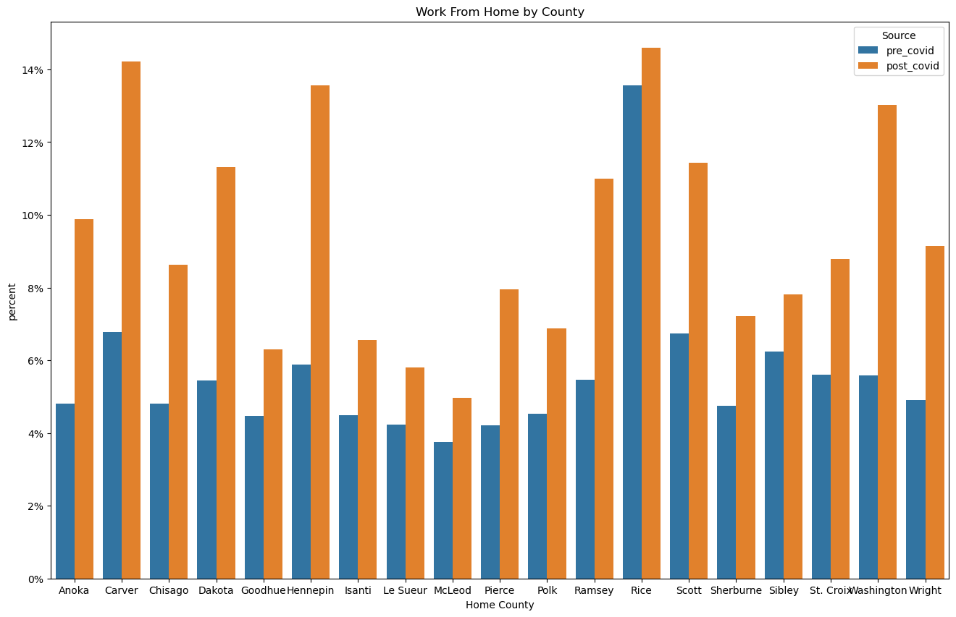
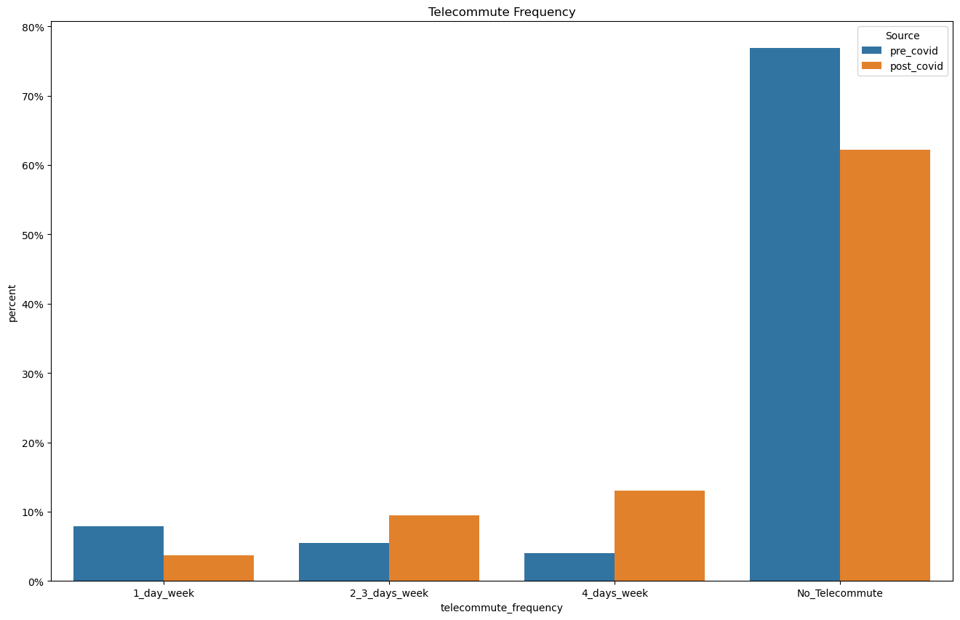
Easy Results

Slide 9
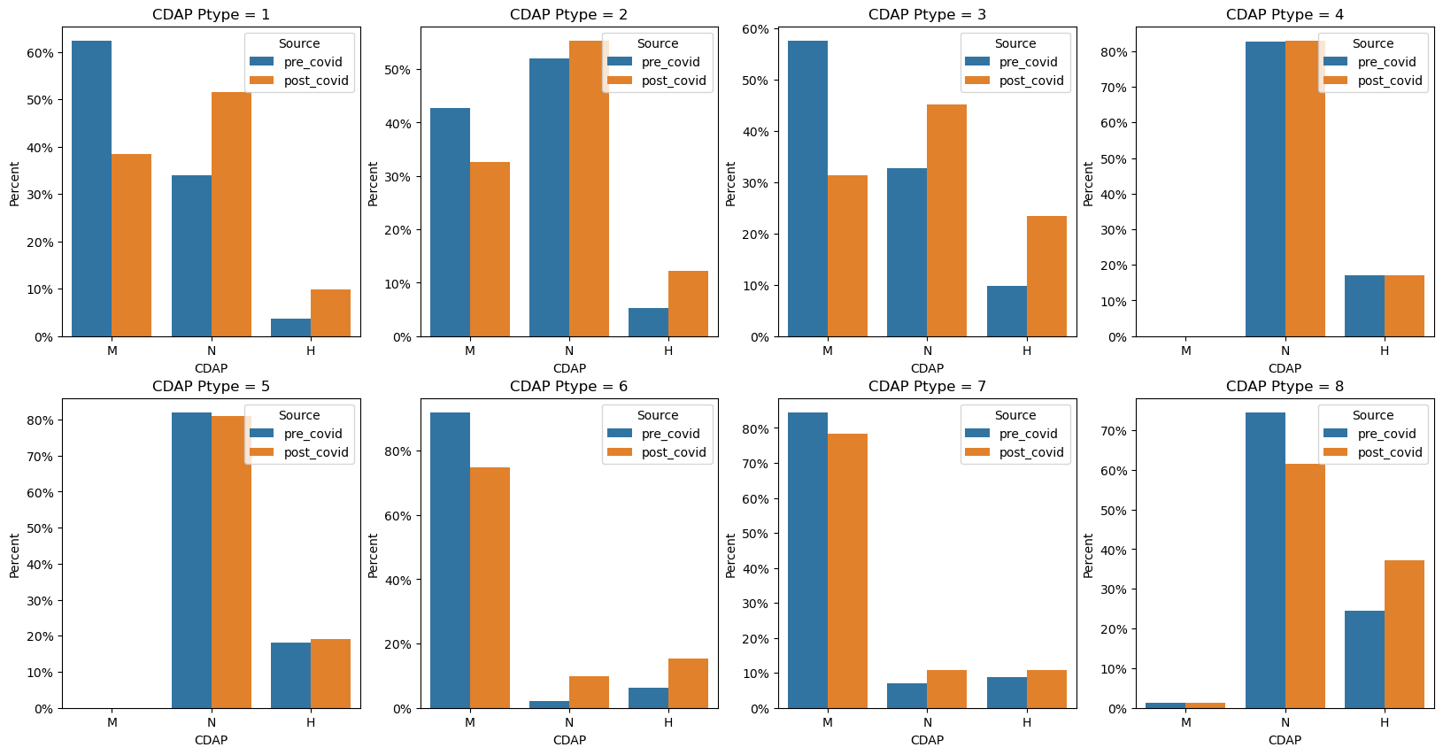
Easy Results

Slide 10
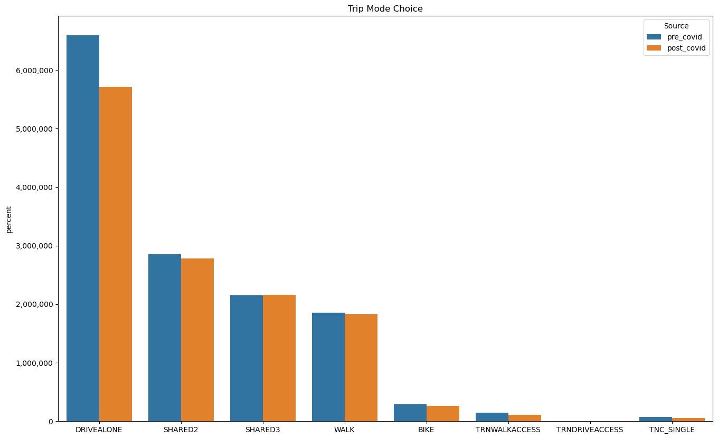
Trip Output Results
 | Asim VMT
Pre-Covid | 95,441,790
Post-Covid | 83,577,873
12.4% VMT Decrease
 | Asim Transit
Pre-Covid | 156,989
Post-Covid | 115,434
26.5% Linked Ridership Decrease
 | Total Trips
Pre-Covid | 14,235,404
Post-Covid | 13,146,988
7.6% Trip Decrease
Notes:
Per MNDOT, the annual VMT per person fell by 7.3%, the model may be overreacting
Per Met Council Transit Data, transit fell by 52%

Slide 11
Conclusions
Periodic surveys can capture trends in travel
Model can react as designed; use caution in unadjusted steps
Such a study brings up lots of questions…
Should the synthetic population remain static?
Should we push to include occupation in synthetic populations?
Should supply (especially transit) remain static?

